Slide 1
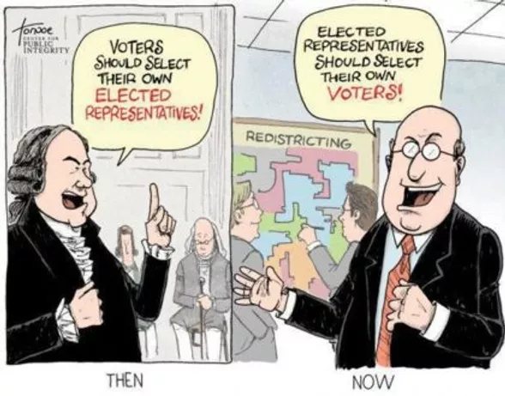
Does my vote count?
Why REDISTRICTING should be important to you.
Notes:
Redistricting just became much more important in North Carolina. PAUSE/CLICK

Slide 2
This is what Redistricting is all about.
In a government “of the people, by the people and for the people”
Should the voters select their representatives, or should the representatives select their voters?
Notes:
The current maps drawn for North Carolina are better than they were – thanks to a court order that forced the maps to be redrawn prior to the last election CLICK, but there are still many “safe districts” drawn to ensure reelection of the incumbent party.
Should the voters select their representatives, or should the representatives select their voters? CLICK

Slide 3
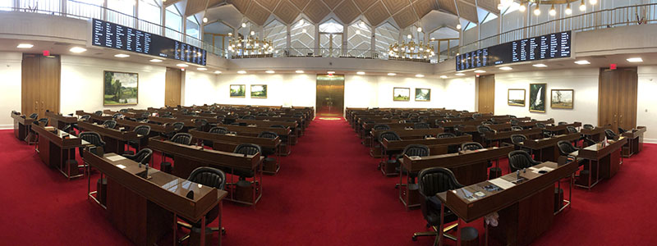
Redistricting influences
2020 Census Data provides NC with 1 additional US Representative!
US House of Representatives
NC Senators
NC House of Representatives
Local County Commissioners
School Districts
Notes:
This impacts Federal, State and local representatives, and is especially important now that NC will have an additional Representative in the US House. The US Senators are elected by, and represent, the entire state.
In North Carolina the maps are created by the LEGISLATURE. CLICK Over the past few years we have managed to get more public hearings and transparency, but this process is still totally controlled by those in office. The goal of the Redistricting groups is to include at least some civilian participation in this process. CLICK

Slide 4
A quick tutorial:
Source: Gerrymandering Explained/The Washington Post
Notes:
Redistricting is a word that usually leaves the listener tuning out – it sounds too complicated to address. In fact, it is a very simple concept. Here’s a quick and very clear demonstration of exactly what options exist when your legislators are “drawing the map”.
PLAY VIDEO/CLICK

Slide 5
Board of Commissioners – How are they elected? Varies by County:
All commissioners are nominated and elected at large (pure at large)
All commissioners are nominated and elected by district (pure district)
Residence in district is required, but nominated and elected at-large
Combination of pure district and pure at large seats
Combination of pure at large seats , with some seats requiring residence in districts, but still nominated/elected at large
Residence in district is required, but nominated and elected at-large
Notes:
So – in addition to the importance of the make-up of the map for federal and state legislators, the maps also determine local districts, precincts and school districts. Again, all of this is done by the elected representatives who have an incentive to make sure the maps ensure their re-election (or at least their party’s control of their position).
There are only 2 counties in North Carolina – Orange and Carteret, CLICK where County Commissioners must reside in their district (and are voted on by residents of their district), but who are nominated and elected at-large (meaning that each commissioner is responsible to represent the entire county, not just their district, in decisions on the Board of Commissioners). CLICK

Slide 6
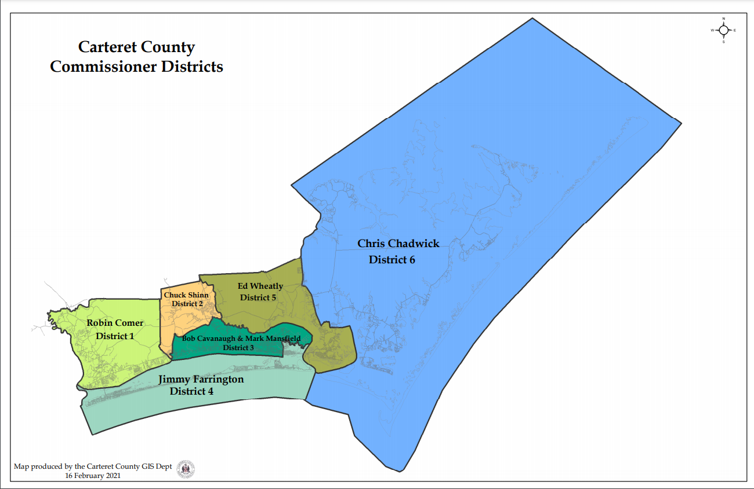
Notes:
This is the current map of Carteret County, showing the Current Commissioners and their district of residence. CLICK

Slide 7
Carteret County Party Affiliation, by District
Notes:
This is not a partisan issue. These next few slides are offered to show you the makeup of voters in Carteret County, and no conclusions are offered or suggested about whether or not the Commissions reflect the demographics and interests of the local community – CLICK 5x you, the voters must make that decision. Do the Commissioners reflect your interests and concerns? This slide shows the party affiliations of voters by District in Carteret County.
Everyone has the right to their own position on this, and they can voice that position BY THEIR VOTES. Every vote is important, and sends a message. CLICK

Slide 8
Notes:
Here is additional demographic data for the county, showing percentage of voters by age, by sex, and by race. The chart in the lower right corner is population by race based on the US Census 2018 ACS Survey data. PAUSE/CLICK
Sources:
Carteret County Voters by Race on left is from the Statevoices.org/BlueprintNC VAN (Voter information) database
Carteret County Population by Race diagram on right source: Source: 2018 American Community Survey 5-Year Estimates
Accessed via US Census Bureau https://data.census.gov/cedsci/
Tables: B25003A through B25003H TENURE (Householder of various races)
Universe: Occupied housing units with a Householder who is of various races
Table B25003 Tenure Universe: Occupied housing units

Slide 9
Carteret County Board of Commissioners
Other Considerations:
Policy positions – education, development, ecology
Advocacy for key community concerns
Key focus of community – agriculture, fishing (commercial vs. recreational), tourism
Notes:
This is the current Carteret County Board of Commissioners. CLICK,
Beyond demographics, there are other factors to consider when determining how to draw the maps. You want a fair representation of the constituents’ policy positions and concerns as well as commissioners who can consider all the important aspects of the local community. CLICK,

Slide 10
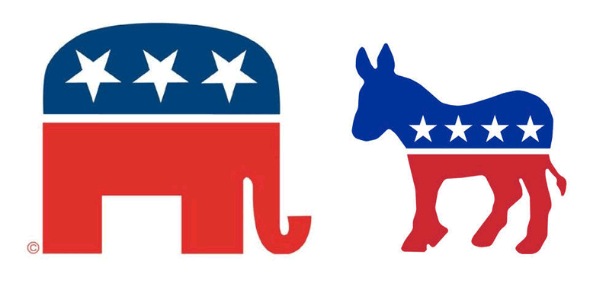
Do all community groups/interests have the opportunity to be represented in local government?
Is it worth running for office if you know that you can’t possibly win the election?
In a FairDistrict map, the VOTERS have the power to elect the person they feel can best represent their interests.
In a Gerrymandered map, the incumbent officials have “safe districts”, and their actions in office have little or no effect on their ability to be re-elected.
Who should control who is in office? The PEOPLE or the PARTIES?
Notes:
Why the maps matter…. PAUSE/CLICK 3x
Who should control who is in office? The PEOPLE or the PARTIES? PAUSE/CLICK

Slide 11
The Five Principles for Reasonable Redistricting Reform
Include the legislature in the process, such as by naming some of the commission’s members
Include citizens and/or impartial experts as commission members, reflecting the state’s racial and other diversity
Set strict rules for the commission's work that: a. apply traditional redistricting standards (compact, contiguous, keep local government units and communities of interest whole) b. do not allow the use of partisan data or partisan objectives c. use voting rules that require bipartisan support for the maps
Provide for extensive citizen participation and transparency
Make the maps final on the commission's vote
Notes:
These are the FairDistrictsNC “Five Principles”. Emphasize key points CLICK 5x. PAUSE/CLICK

Slide 12
Source: https://www.fairdistrictsnc.org/legislation-introduced?fbclid=IwAR17hbiz4J7SvO1I0BBRYTCPxCkahoORUsZAyujtJjbjH7nzsXVfhobAX88
Notes:
This is the current Redistricting Legislation in NC. – all of which is still in committee.
The Goal: to have them pass ANYTHING that involves redistricting would be a plus - Different legislation, some better than others. Some only involve the legislation actions, some would require an amendment to the NC Constitution. We need the bills to get to the floor for discussion, debate, and vote.
It is unrealistic to expect to go from a legislature-drawn map to an independent commission map. Hopefully legislation can be passed that will include at least requirements for public input and transparency, and hopefully at least some citizens included in the map drawing committee. PAUSE/CLICK

Slide 13
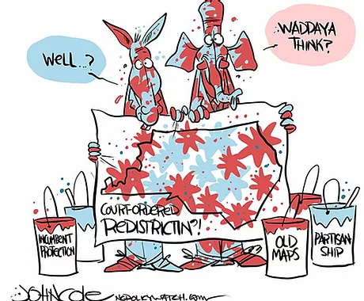
More Information about Redistricting:
NC Legislative and Congressional Redistricting
Understanding Redistricting
Notes:
If we have sparked your interest (and hopefully we have), here is where you can get additional information on this. PAUSE/CLICK

Slide 14
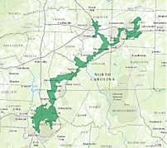
Call to Action
Go and endorse the 5 Principles
Contact Representatives and ask them to endorse the 5 Principles, ask them to support Redistricting Legislation
Discuss topic with family and friends; try to generate increased awareness and involvement
VOTE – in every election, and encourage others to do so as well
NC US District 12
Notes:
So – what can YOU do.
Care – Learn – Promote – VOTE!
And let your representatives know that this is an important topic for you. The more we reach out to them, the sooner the legislation will get out of committee and onto the floor for a vote.

Slide 15
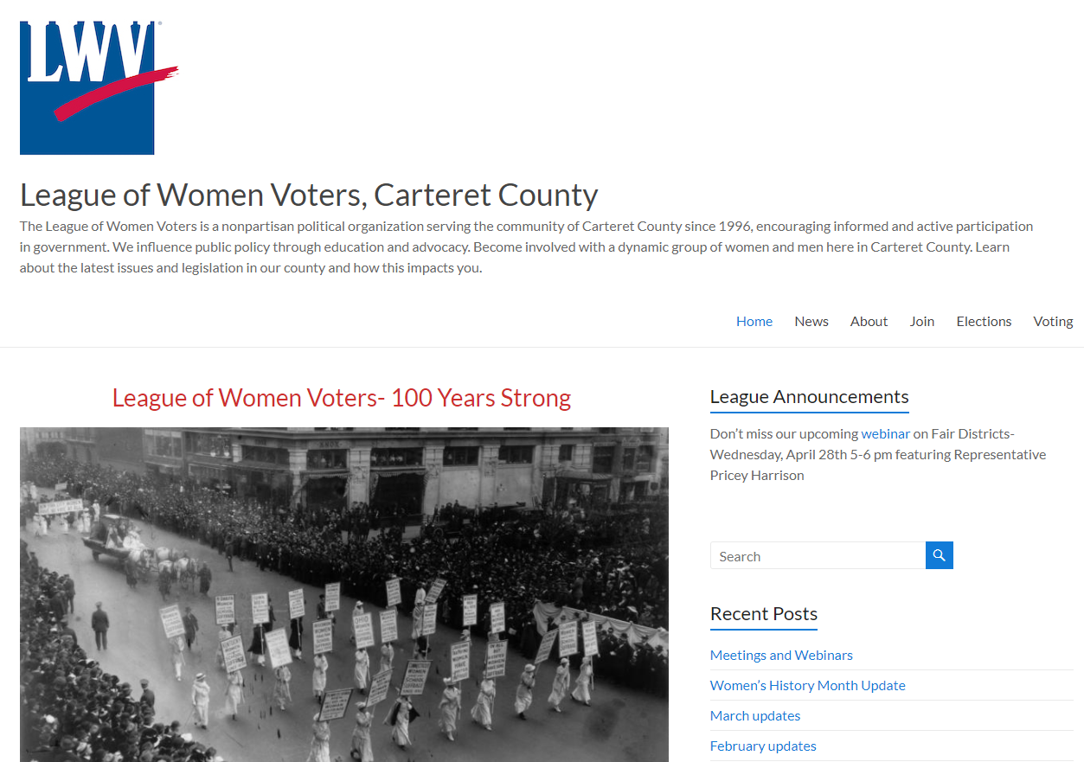
Thank you for your interest, and please contact us if you have any questions:
Phone: 252-728-6385 Email us at:
lwv.nc.cc@gmail.com
Notes:
Are there any questions? PAUSE/RESPOND If you think of something later, here is how to get in touch with us at LWV at Carteret County PAUSE/CLICK

